Slide 1
Y253400167
Calibration test report
10/03/2025
Lightmatter Confidential

Slide 2
General flow
Kurtz: Using hand waving discussion clm control - Google Slides for reference
See page 6 for detailed implementation
Marlow firmware: 1.2
Use Kurtz 1d calibration file as setting points, with 15mA VOA settings

Slide 3
Endeavour spec (14 mW)

Slide 4
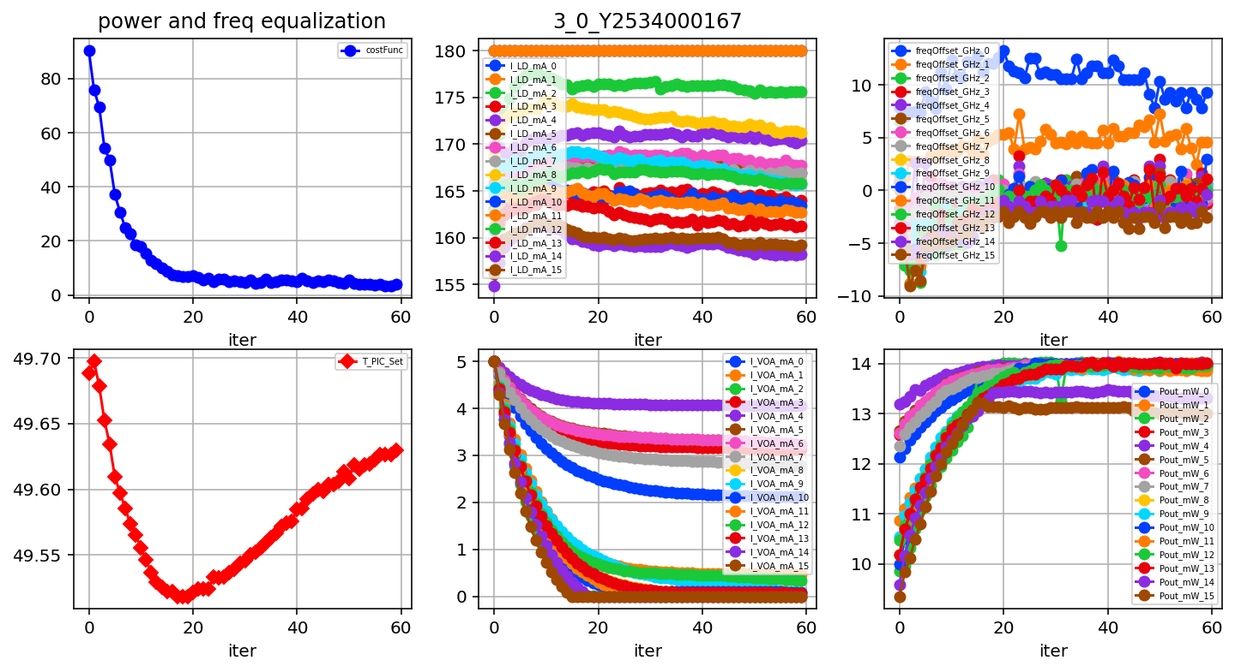
Package Y253400167, Tile 3, ch equalization, Endeavour, Kurtz

Slide 5
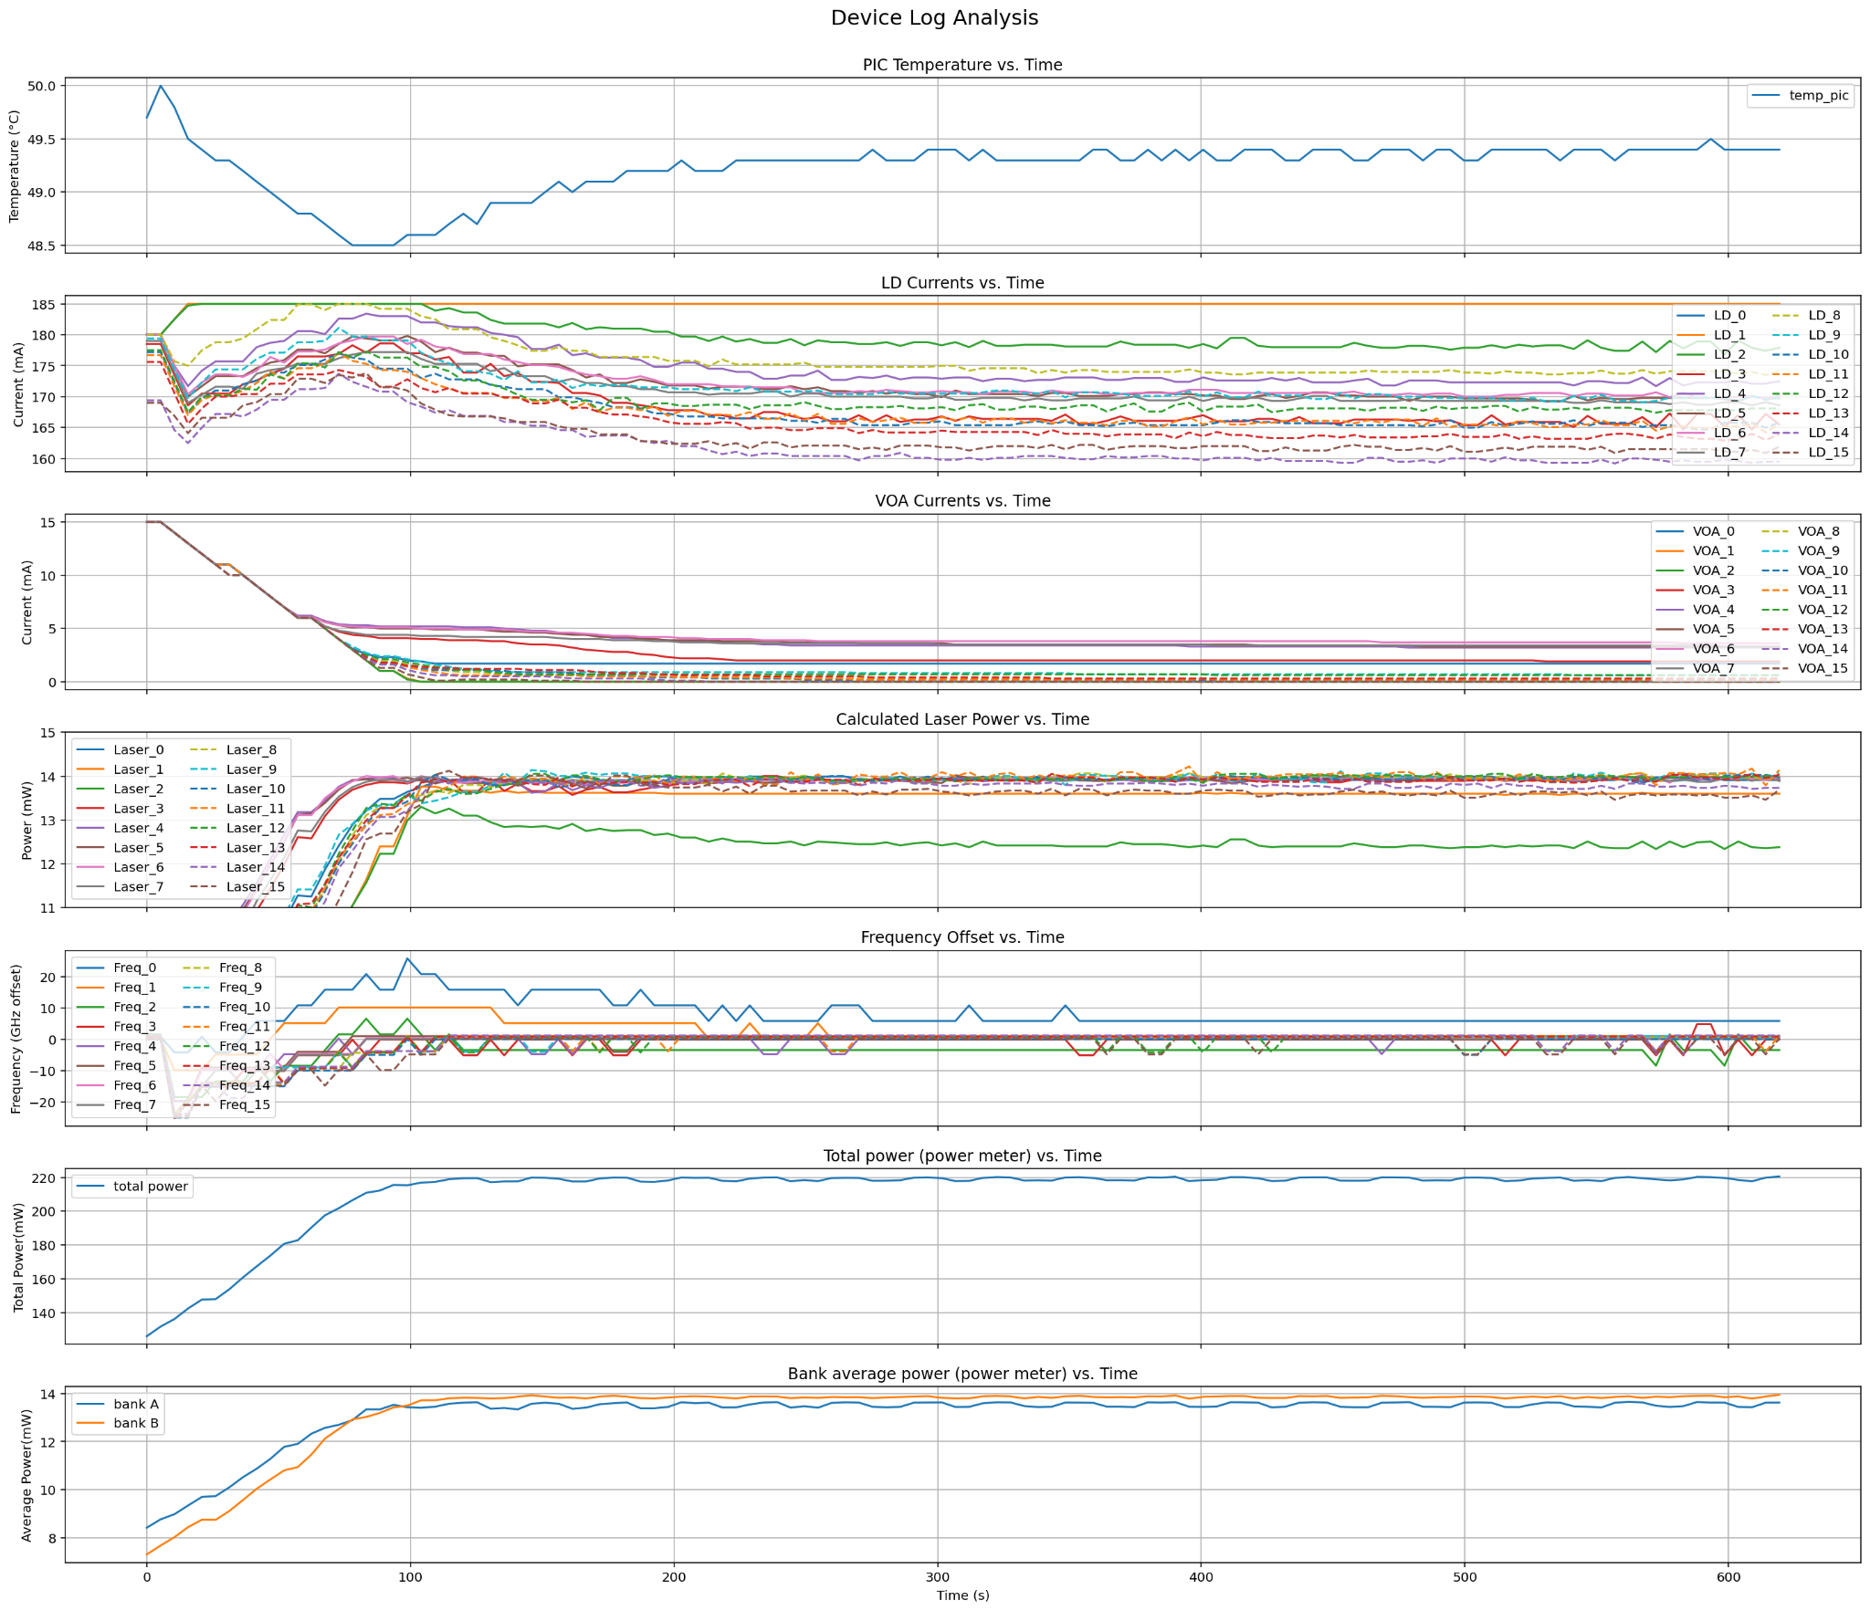
Package Y253400167, Tile 3, ch equalization, Endeavor
Marlow 1.2

Slide 6
Kenya spec (6.4 mW)

Slide 7
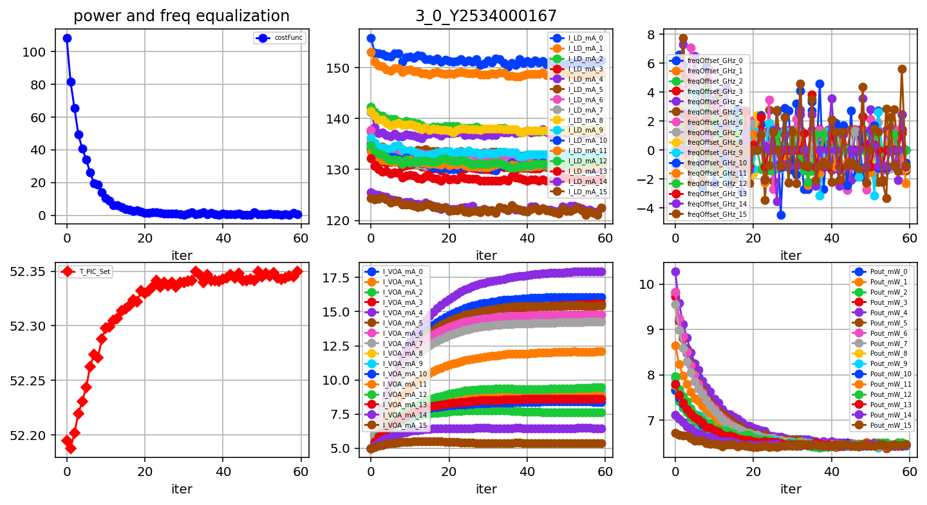
Package Y253400167, Tile 3, ch equalization, Kenya, New procedure

Slide 8
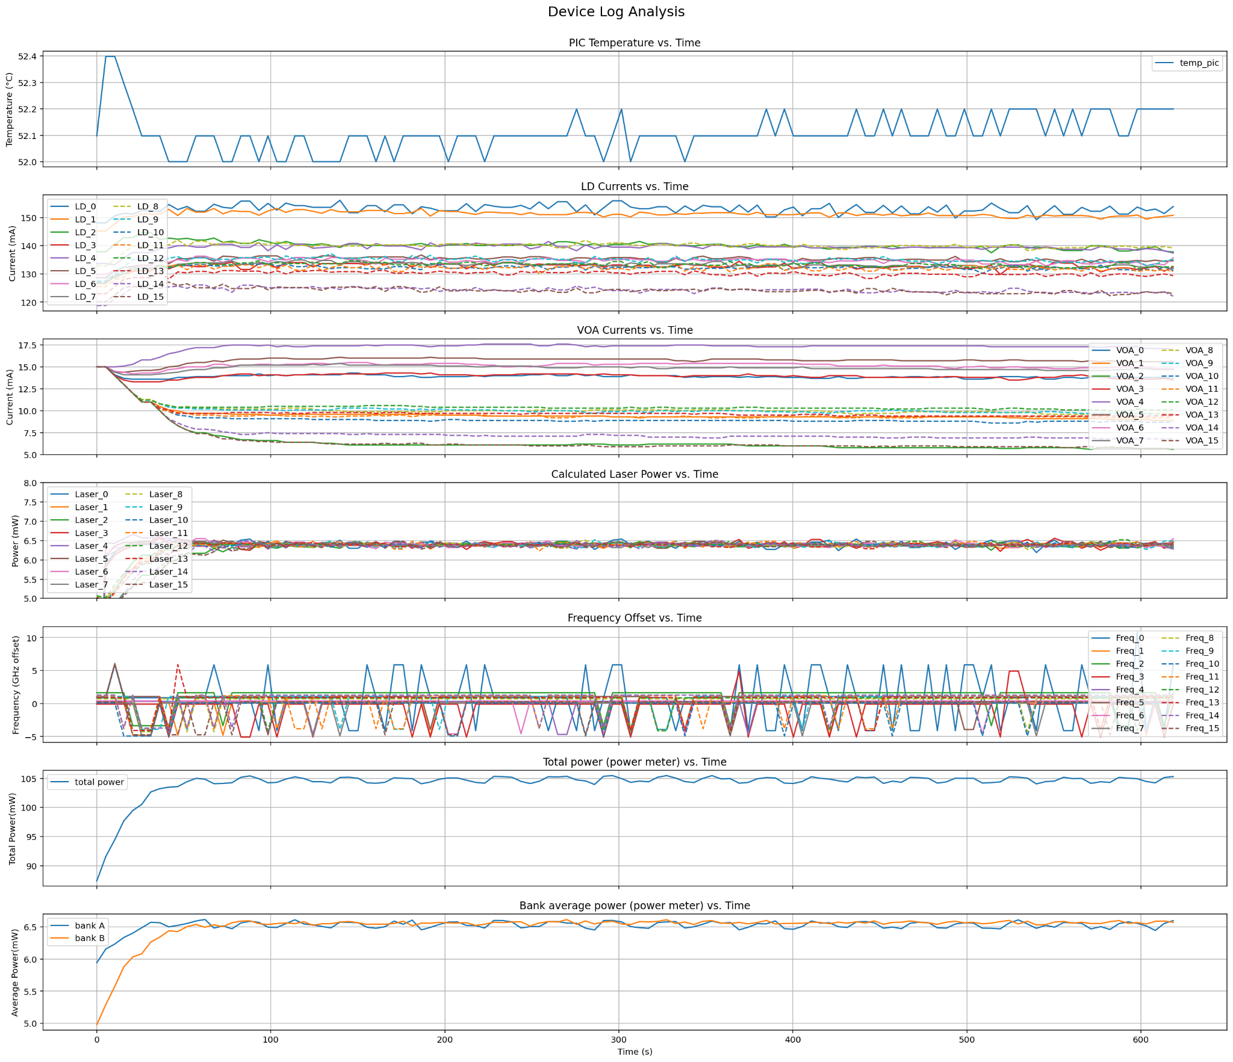
Package Y253400167, Tile 3, ch equalization, Kenya
Marlow 1.2

